Slide 2
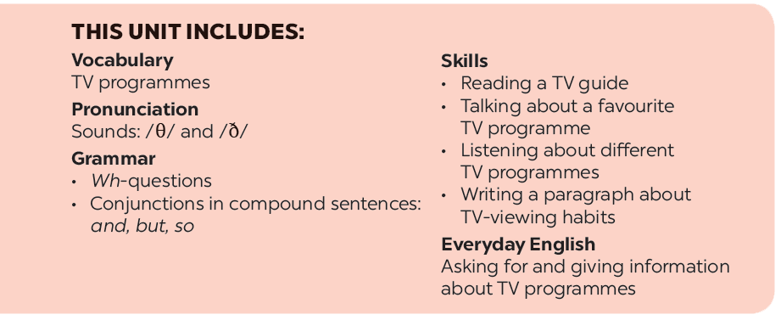

Slide 3
Everyday English
TV progammes
Asking for and giving information about TV programmes
Work in groups. Discuss and complete the facts with the countries in the box.
Listen and read the conversation. Pay attention to the highlighted words.
Read about the two TV programmes and tick () the correct programme in the table. You may tick both.
Work in pairs. Make a similar conversation about your favourite TV programme.
Work in groups. Tell your group which programme in 4 you prefer and why.

Slide 4
Wednesday,January 19th 2022
Unit 7:Television
Lesson 4:Communication p.11

Slide 5
Everyday English
Asking for and giving information about TV programmes

Slide 6
Listen and read the conversation. Pay attention to the highlighted words.
A: What’s your favourite TV programme?
B: The animal programme.
A: Why do you like it?
B: Because I can see the animals in their real life.

Slide 7
Work in pairs. Make a similar conversation about your favourite TV programme.

Slide 8
TV progammes

Slide 9
Work in groups. Discuss and complete the facts with the countries in the box.
The USA
Viet Nam
Japan
Iceland
Facts
1.
Pokemon cartoons are from
_______.
Japan.
2.
Bibi in
_______ shows international and Vietnamese cartoons.
Viet Nam shows international and Vietnamese cartoons.
3.
In
_______, there was no TV on Thursdays before 1986.
Iceland, there was no TV on Thursdays before 1986.
4.
Discovery Channel makes education fun for children in
the USA.
_______.

Slide 10
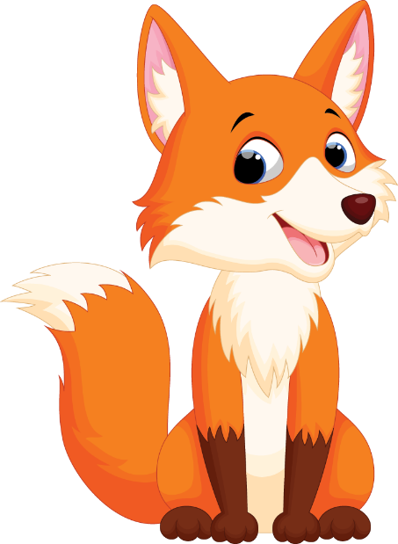
Read about the two TV programmes and tick () the correct programme in the table. You may tick both.
Let’s Learn is an educational TV programme. It makes learning fun. Children love it. It has cute characters and fun songs. People in 80 countries watch it today. Both children and their parents like it.
Hello Fatty is a popular TV cartoon. It’s about a clever fox called Fatty and his friend. Together they go to different places. Children around the world enjoy this programme. It’s funny and educational.
Notes:
City landmarks phải ở trên mục 3

Slide 11
 | Let’s Learn | Hello Fatty
1. It’s educational.
2. It has viewers from 80 countries.
3. Its main character is a clever fox.
4. Both parents and children enjoy it.
5. It’s a cartoon.







Slide 12
Work in groups. Tell your group which programme in 4 you prefer and why.
Example:
I like Let’s Learn because it has cute characters and fun songs.

Slide 13
Home Assignments
Review vocabulary
-Do EX in part C p.5-6 in WB.

